Slide 1
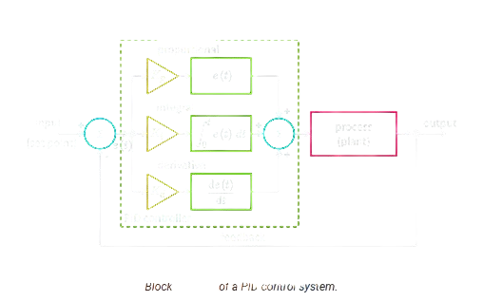
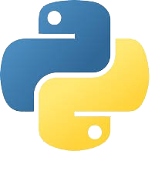
Implementing a PID Controller Algorithm in Python

Slide 2













PID control system block diagram
Kp
$$ⅇ\left(t\right)$$
$$+$$
$$\int_{0}^{t}{ⅇ\left(τ\right)ⅆτ}$$
Process
(Plant)
Output
Input
Setpoint
$$Σ$$
Ki
$$Σ$$
$$ⅇ\left(t\right)$$
$$+$$
$$u\left(t\right)$$
-
$$\frac{ⅆⅇ\left(t\right)}{ⅆt}$$
$$+$$
Kd
PID Controller
Feedback
Mali Martin

Slide 3

Equation
$u\left(t\right)$ = $k_{P}ⅇ\left(t\right)$ + $k_{i}\int_{0}^{t}{ⅇ\left(τ\right)ⅆτ}$ + $k_{d}$ $\frac{ⅆⅇ\left(t\right)}{ⅆt}$
Propotional
Integral
Derivative
Mali Martin

Slide 4
Importing Libraries
from IPython import get_ipython
from IPython.display import display
import time
import matplotlib.pyplot as plt
import numpy as np
Mali Martin

Slide 5
PID control functrtion
def pid_controller(setpoint, pv, kp, ki, kd, previous_error, integral, dt):
error = setpoint - pv
integral += error * dt
derivative = (error - previous_error) / dt
control = kp * error + ki * integral + kd * derivative
return control, error, integral
Mali Martin

Slide 6
Data storage initialization
time_steps = []
pv_values = []
control_values = []
setpoint_values = []
Mali Martin

Slide 7
Main simulation function
def main():
setpoint = 100 # Desired setpoint
pv = 0 # Initial process variable
kp = 1.0 # Proportional gain
ki = 0.1 # Integral gain
kd = 0.05 # Derivative gain
previous_error = 0
integral = 0
dt = 0.1 # Time step
Mali Martin

Slide 8
Simulation Loop
for i in range(100): # Simulate for 100 time steps
control, error, integral = pid_controller(setpoint, pv, kp, ki, kd,
previous_error, integral, dt)
pv += control * dt
previous_error = error
time_steps.append(i * dt)
pv_values.append(pv)
control_values.append(control)
setpoint_values.append(setpoint)
time.sleep(dt)
main()
Mali Martin

Slide 9
Ploting
plt.figure(figsize=(12, 6))
plt.subplot(2, 1, 1)
plt.plot(time_steps, pv_values, label='Process Variable (PV)')
plt.plot(time_steps, setpoint_values, label='Setpoint', linestyle='--')
plt.xlabel('Time (s)')
plt.ylabel('Value')
plt.title('Process Variable vs. Setpoint')
plt.legend()
plt.subplot(2, 1, 2)
plt.plot(time_steps, control_values, label='Control Output')
plt.xlabel('Time (s)')
plt.ylabel('Control Output')
plt.title('Control Output over Time')
plt.legend()
plt.tight_layout()
plt.show()
Mali Martin

Slide 10
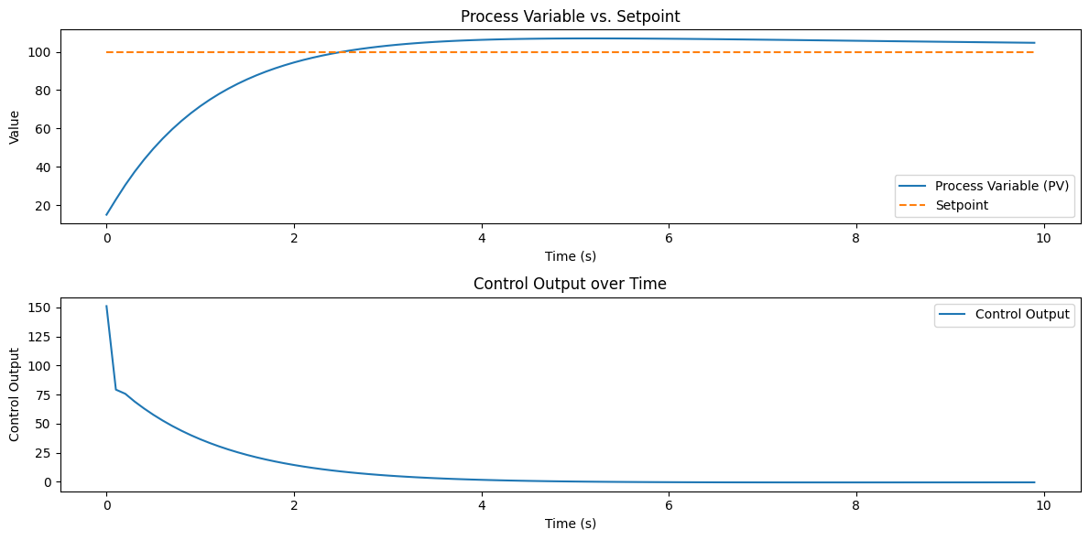
Graphs

Slide 11
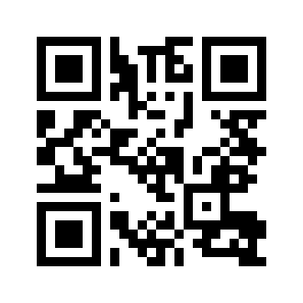
Linkup

